Slide 1
Line Integrals & Vector Fields Q&A

Slide 2
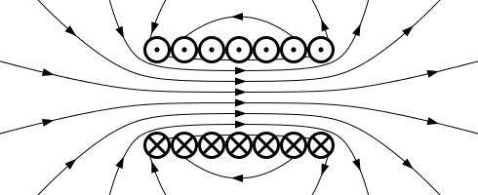
Can Maxwell’s equations be used for other applications besides electricity?

Slide 3
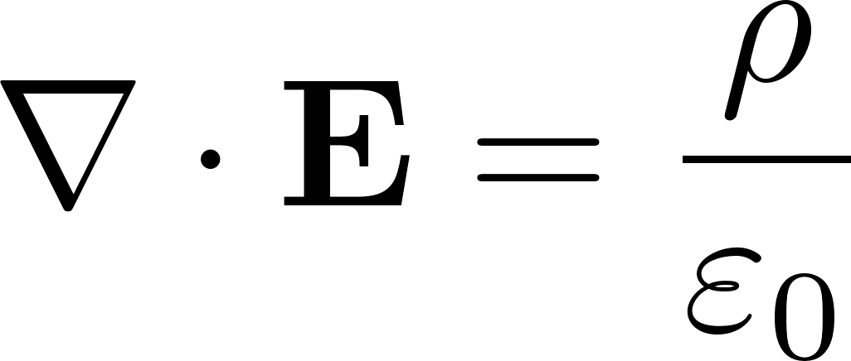


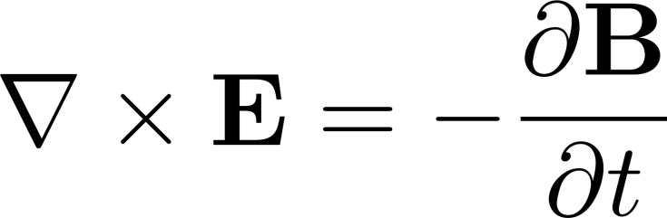

Why are the four Maxwell equations connected?
Ampere’s Law
Gauss’s Law
Lorentz Force
Faraday’s Law
Gauss’s Law for Magnetism

Slide 4

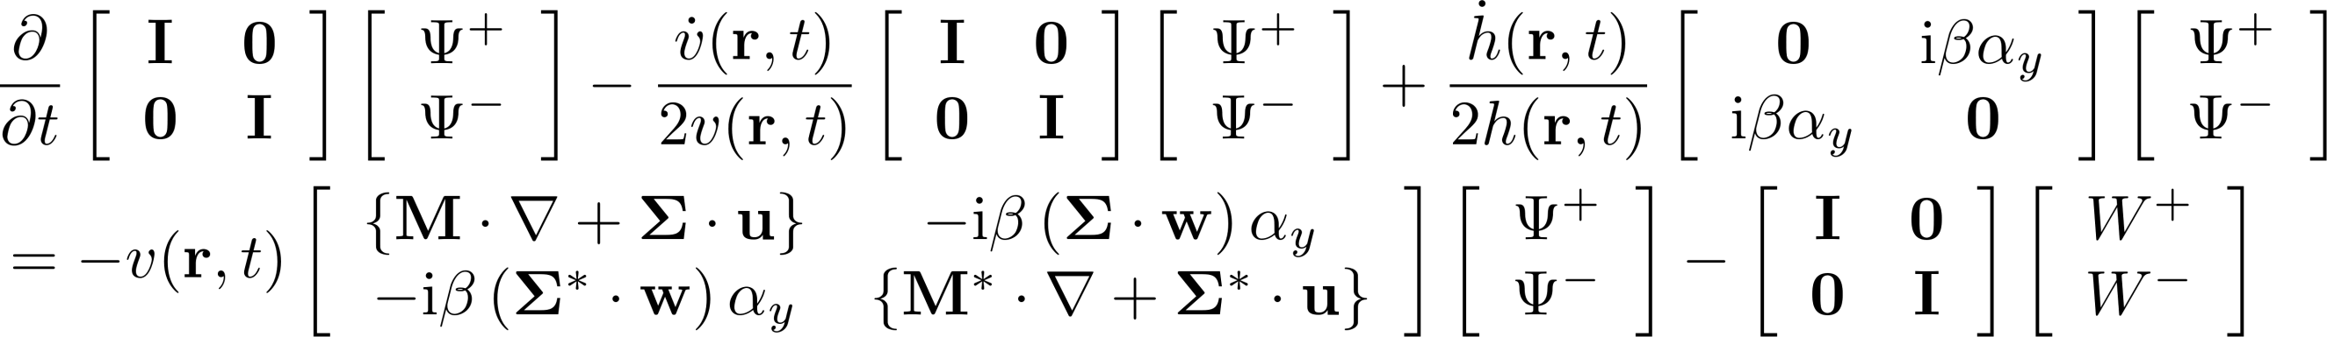
How do you write Maxwell’s equations as one equation?

Slide 5
Green’s Theorem and Vector Line Integrals

Slide 6
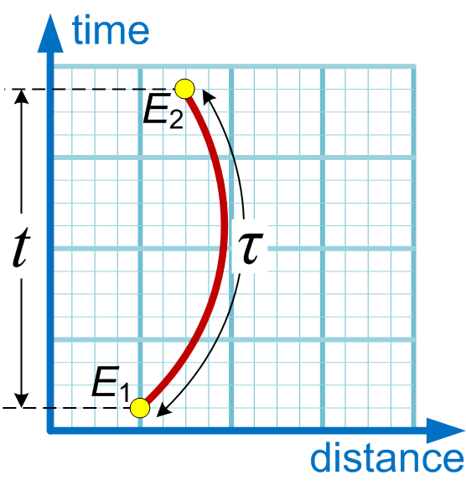
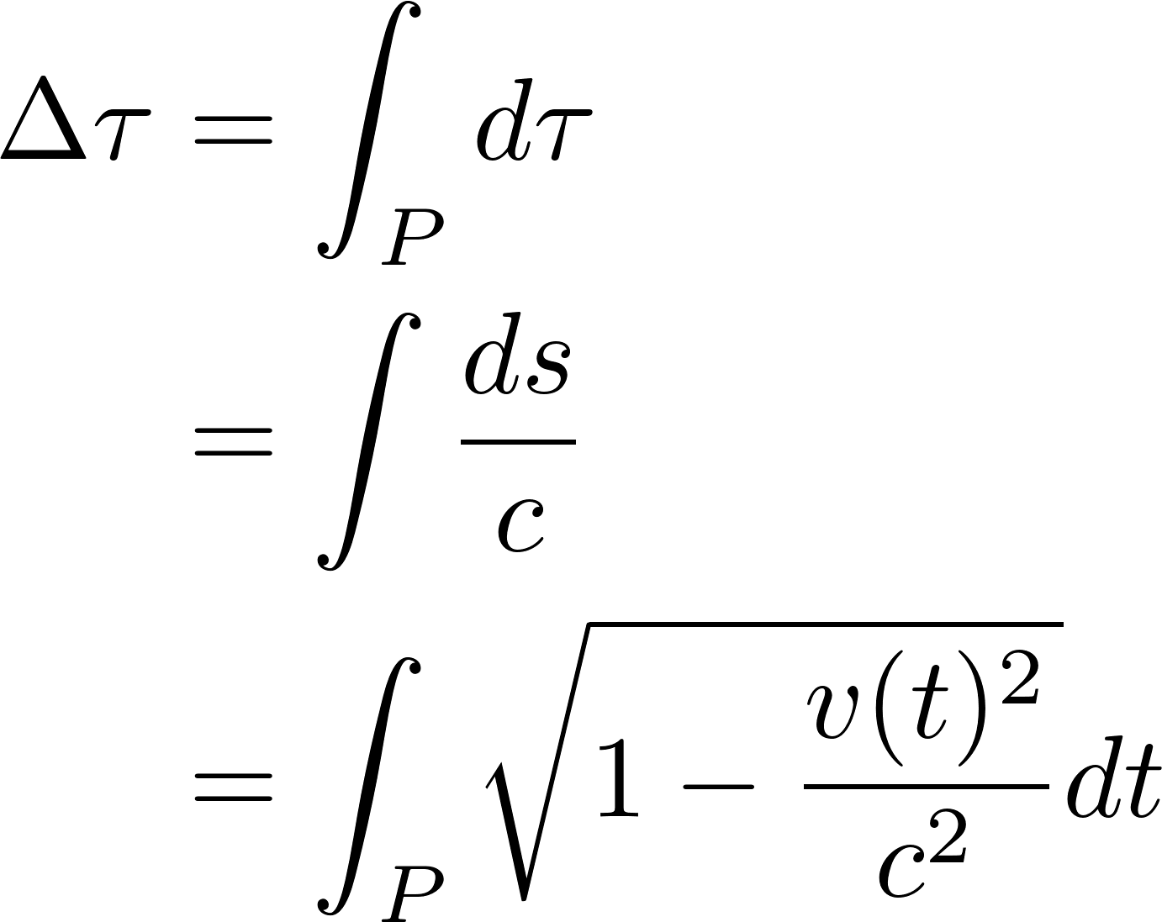
Proper Time in Special Relativity

Slide 7
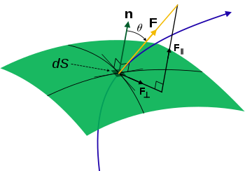
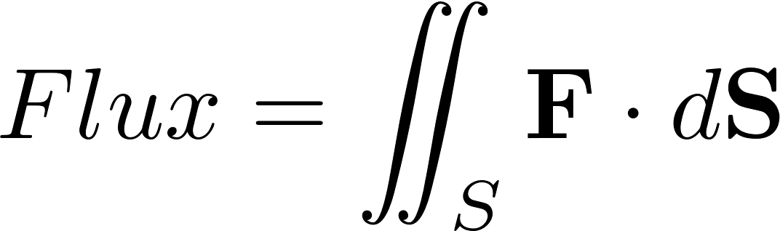
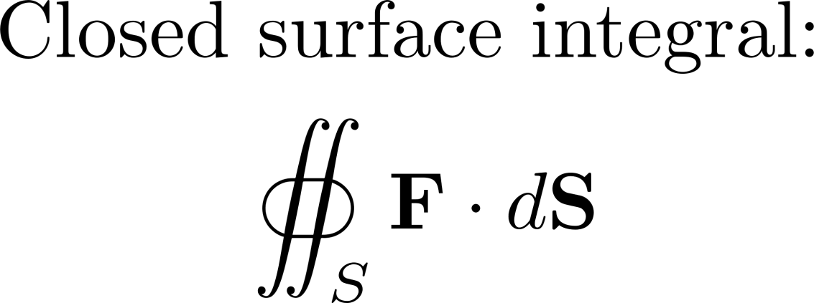
Surface Integrals and Flux

Slide 8
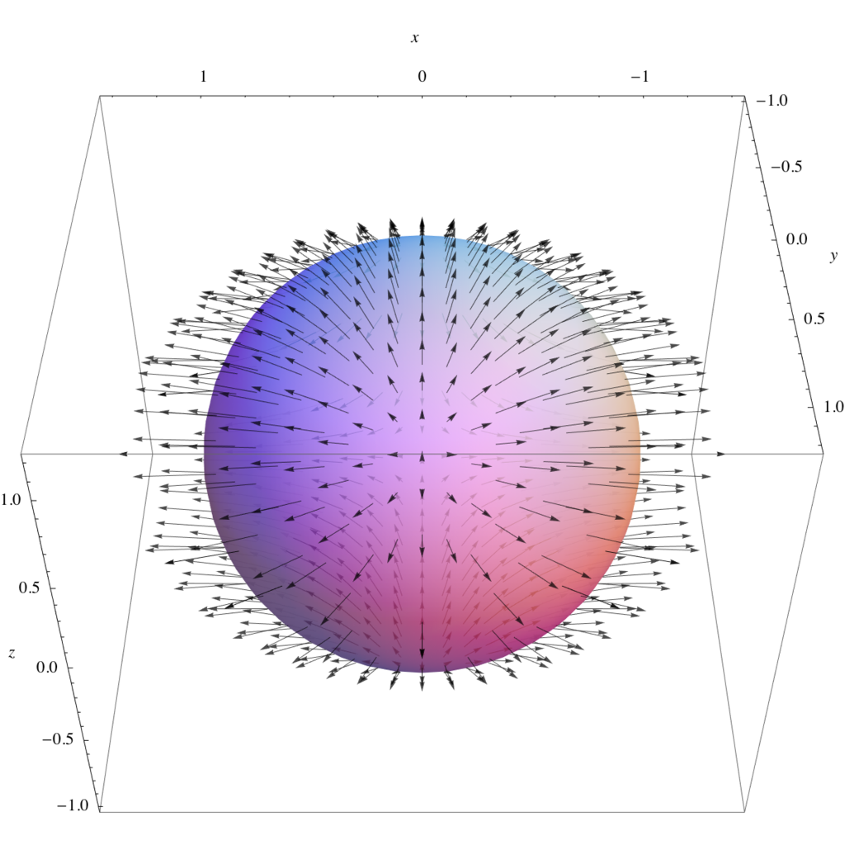
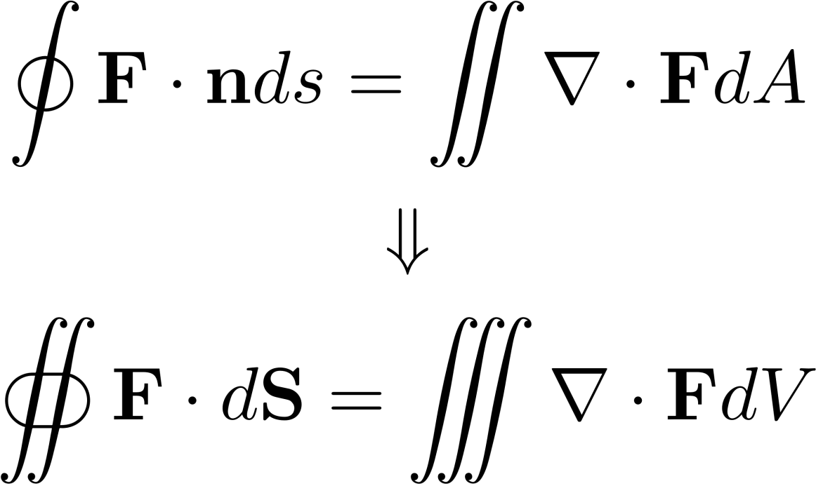
Divergence Theorem

Slide 9
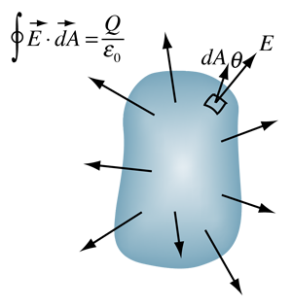
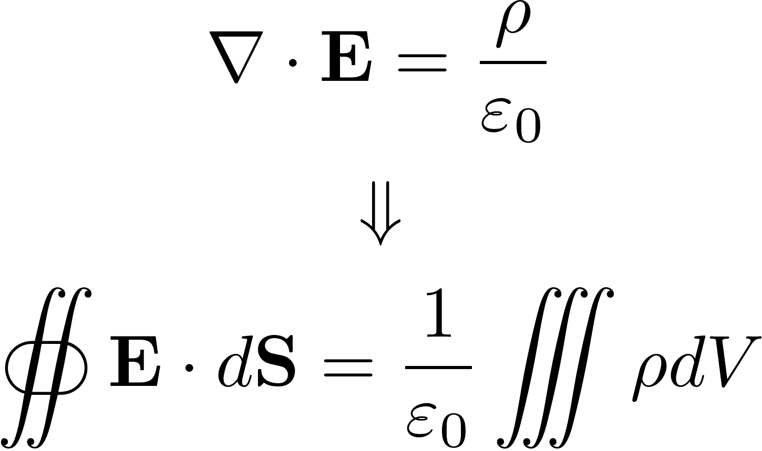
Integral Form of Gauss’s Law

Slide 10
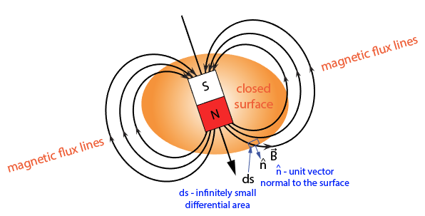
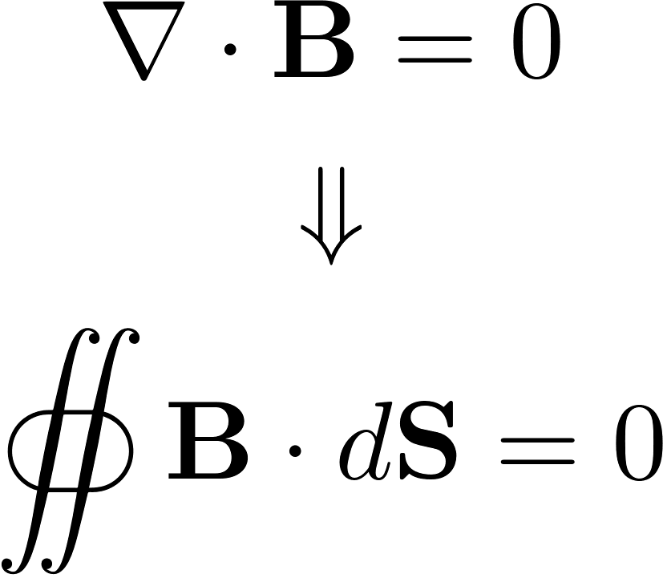
Integral Form of Gauss’s Law for Magnetism

Slide 11
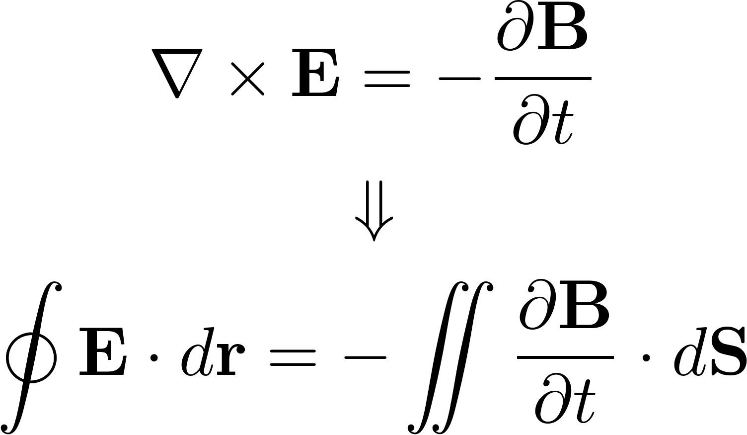
Integral Form of Faraday’s Law

Slide 12
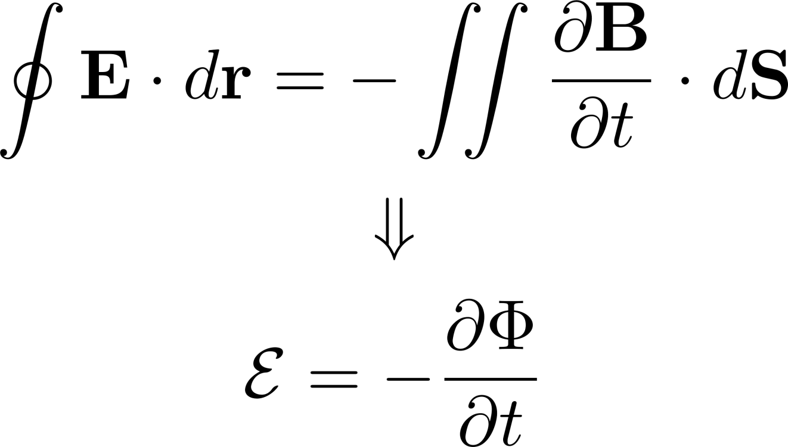
Lenz’s Law

Slide 13
Inductors

Slide 14
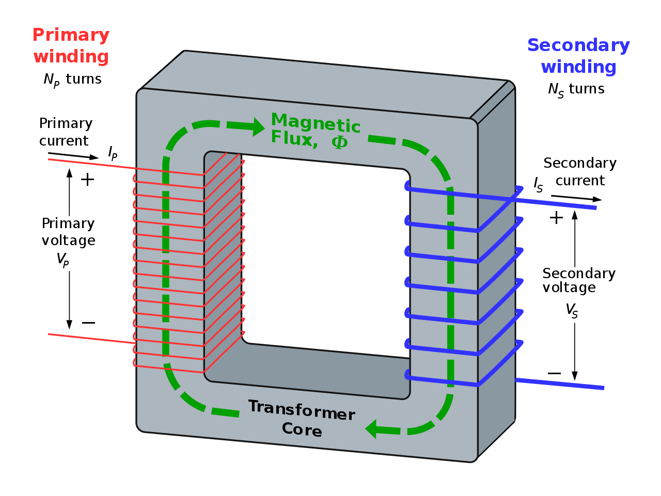
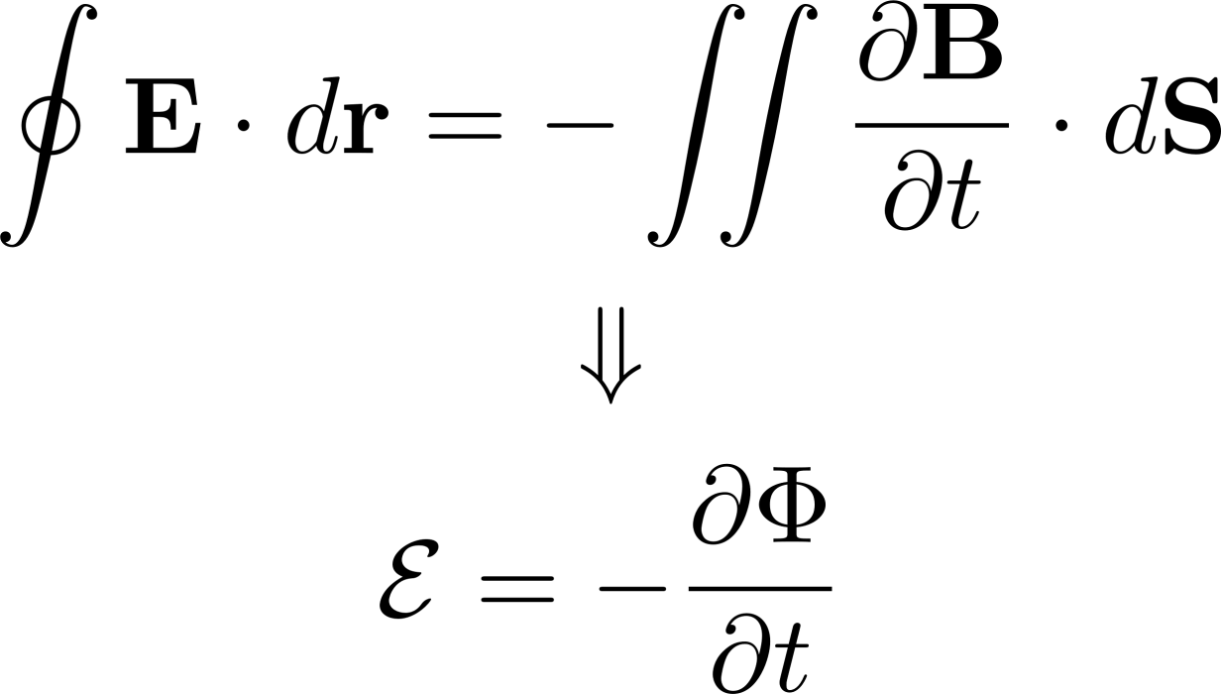
Transformers

Slide 15
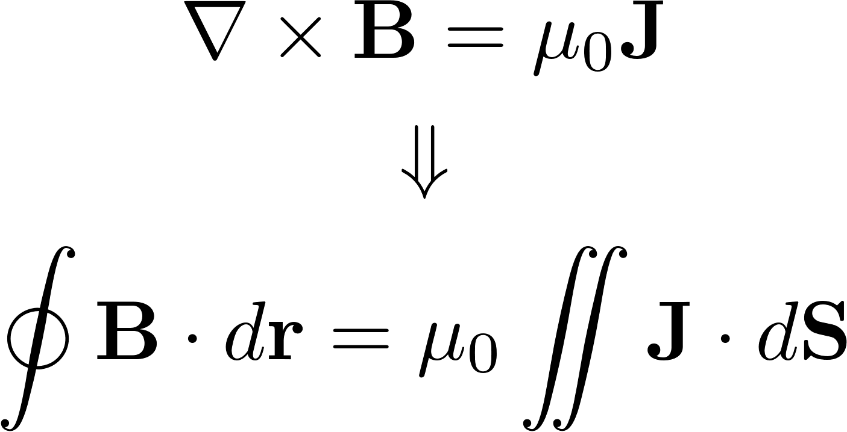
Integral Form of Ampere’s Law

Slide 16
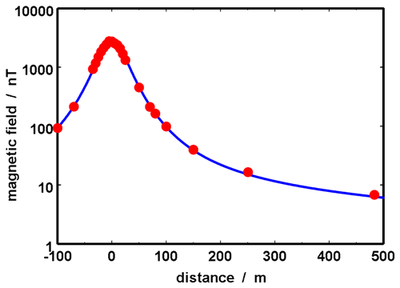
Transmission Lines

Slide 17
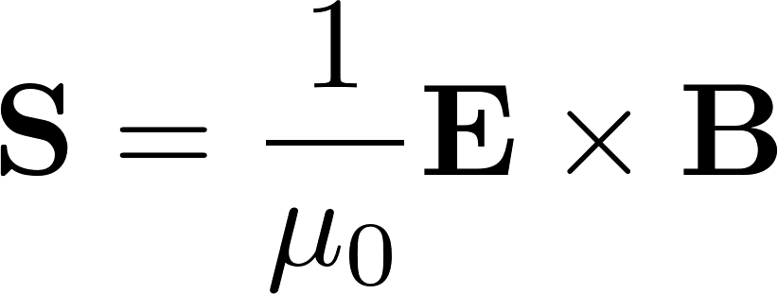
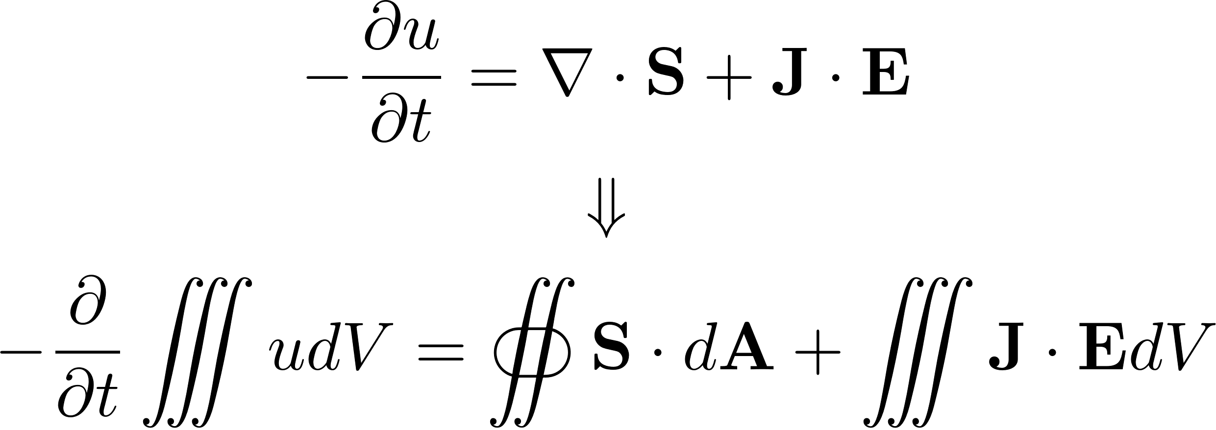
Poynting’s Theorem

